Slide 1
Introduction to Fourier Neural Operators
Hilary Wu

Slide 2
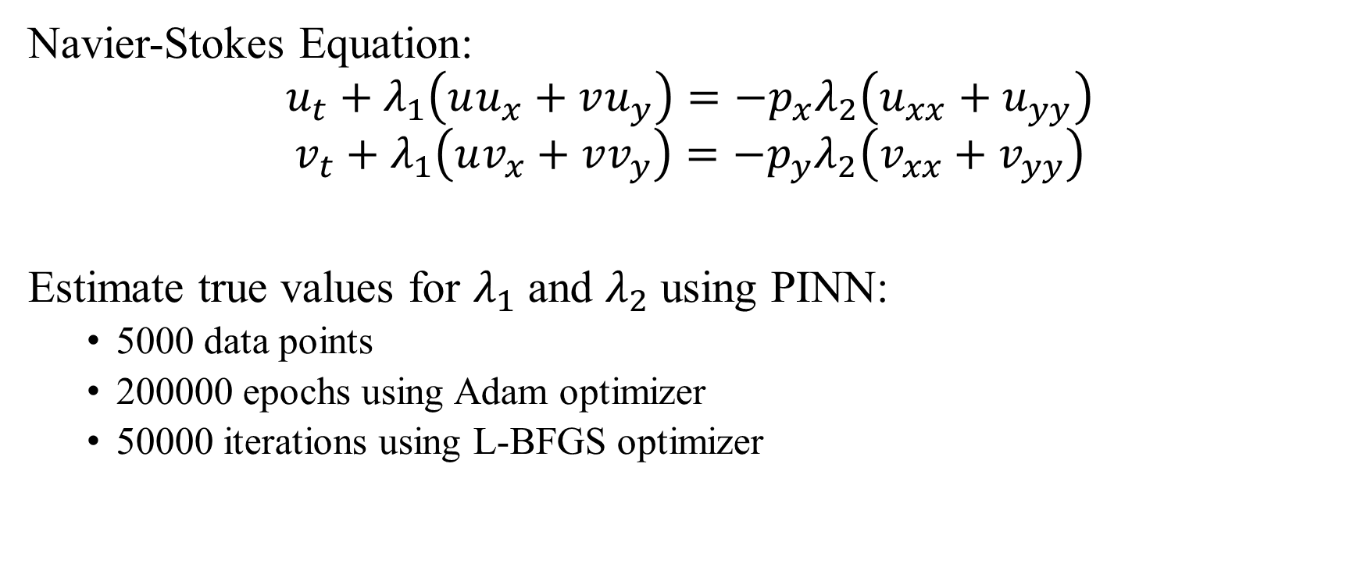
Data driven discovery of PDEs
Navier-Stokes Equation:
$$u_{t}+λ_{1}\left(uu_{x}+vu_{y}\right)=−p_{x}λ_{2}\left(u_{xx}+u_{yy}\right)$$
$$v_{t}+λ_{1}\left(uv_{x}+vv_{y}\right)=−p_{y}λ_{2}\left(v_{xx}+v_{yy}\right)$$
Estimate true values for $λ_{1}$ and $λ_{2}$ using PINN:
5000 data points
200000 epochs using Adam optimizer
50000 iterations using L-BFGS optimizer

Slide 3
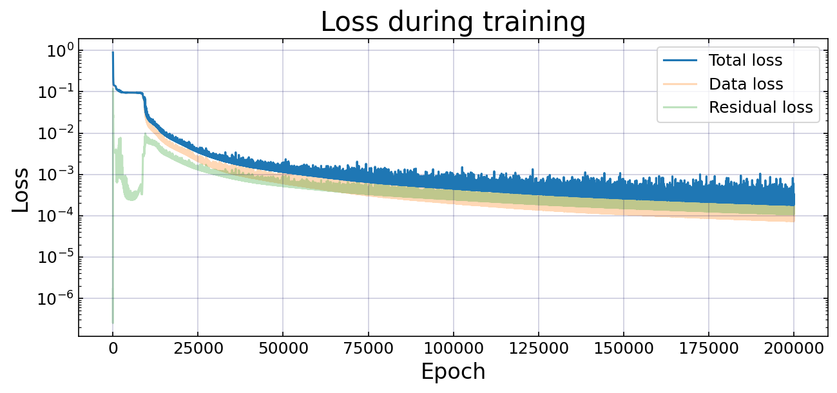
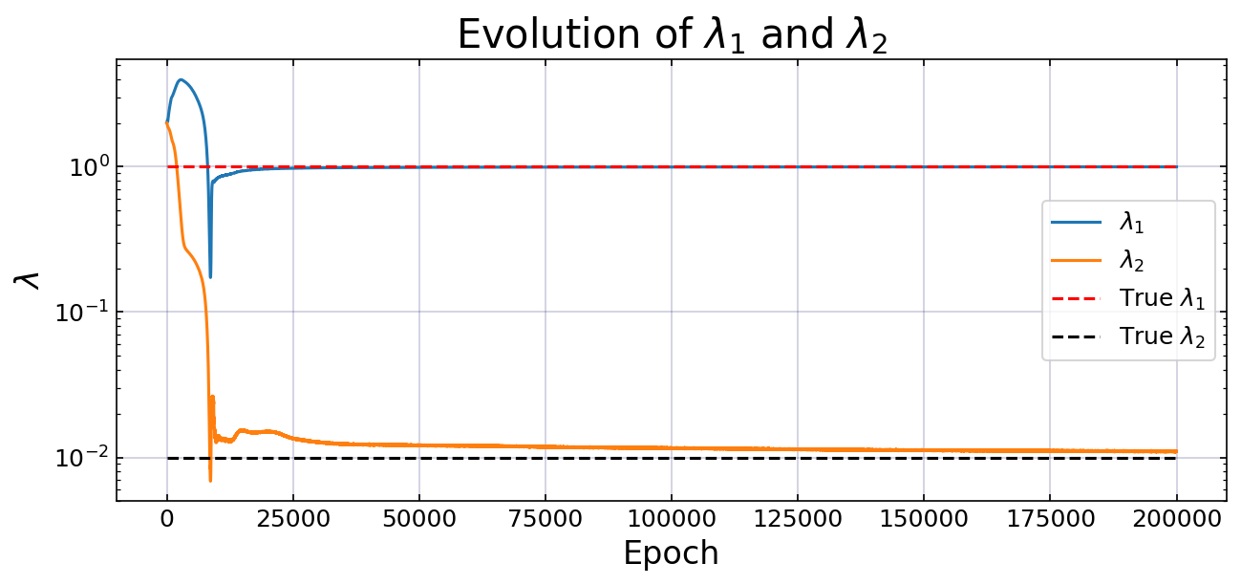

Slide 4
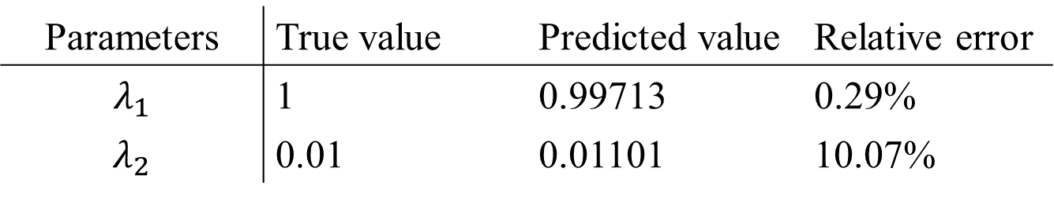

Results
$>9$ hours of training time
What if we want to predict a solution to the Navier-Stokes equation using the same parameters but different initial/boundary conditions?
Parameters | True value | Predicted value | Relative error
$$λ_{1}$$ | 1 | 0.99713 | 0.29%
$$λ_{2}$$ | 0.01 | 0.01101 | 10.07%

Slide 5
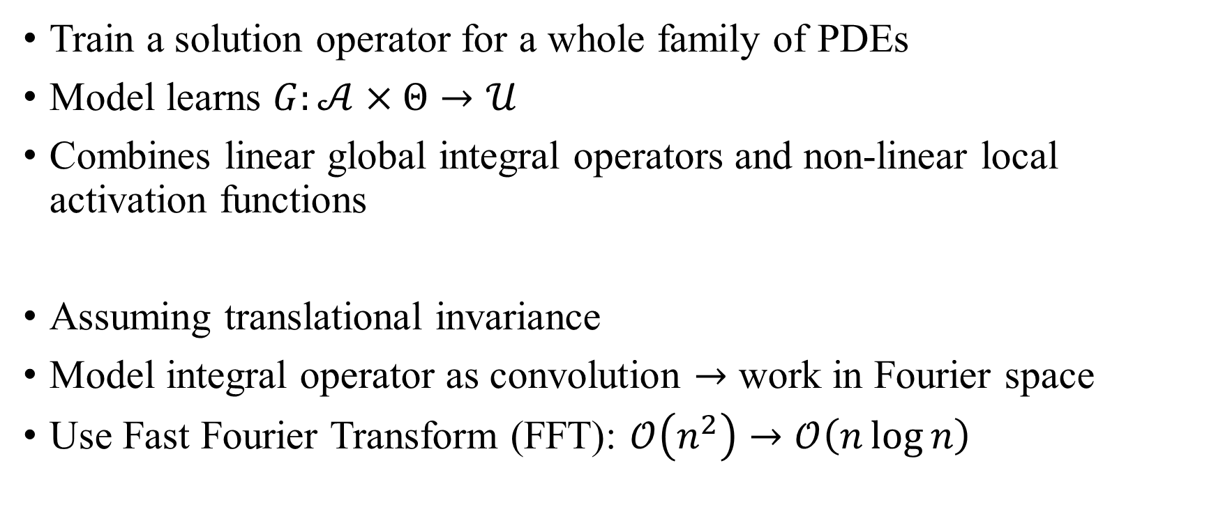
Fourier Neural Operators (FNOs)
Train a solution operator for a whole family of PDEs
Model learns $G:𝒜×Θ→𝒰$
Combines linear global integral operators and non-linear local activation functions
Assuming translational invariance
Model integral operator as convolution $→$ work in Fourier space
Use Fast Fourier Transform (FFT): $𝒪\left(n^{2}\right)→𝒪\left(n\log{n}\right)$

Slide 6

High level architecture
Start from input $a ε 𝒜$
Lift to higher dimension channel space by neural network P
Apply multiple layers of integral operators and activation functions
Project back to target dimension by neural network Q
Output $u ε 𝒰$

Slide 7
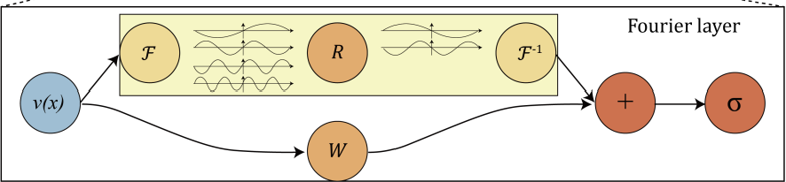
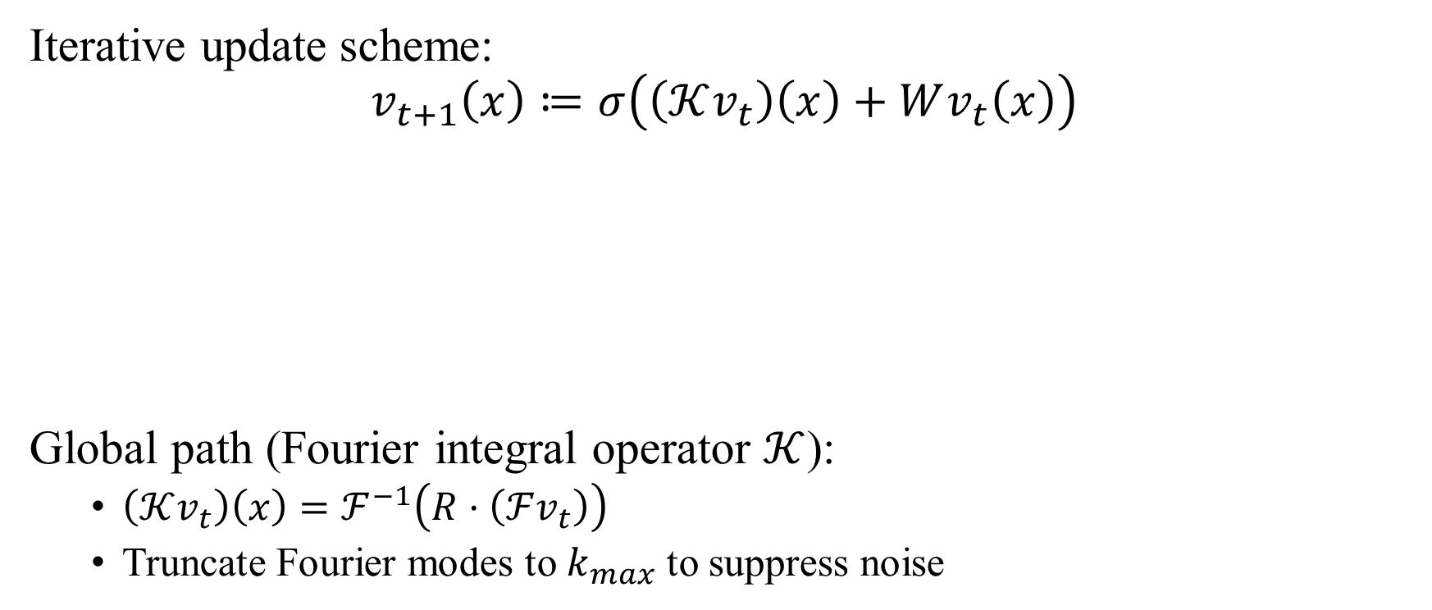
Fourier layers
Iterative update scheme:
$$v_{t+1}\left(x\right)≔σ\left(\left(𝒦v_{t}\right)\left(x\right)+Wv_{t}\left(x\right)\right)$$
Global path (Fourier integral operator $𝒦$):
$\left(𝒦v_{t}\right)\left(x\right)=ℱ^{−1}\left(R·\left(ℱv_{t}\right)\right)$
Truncate Fourier modes to $k_{max}$ to suppress noise

Slide 8
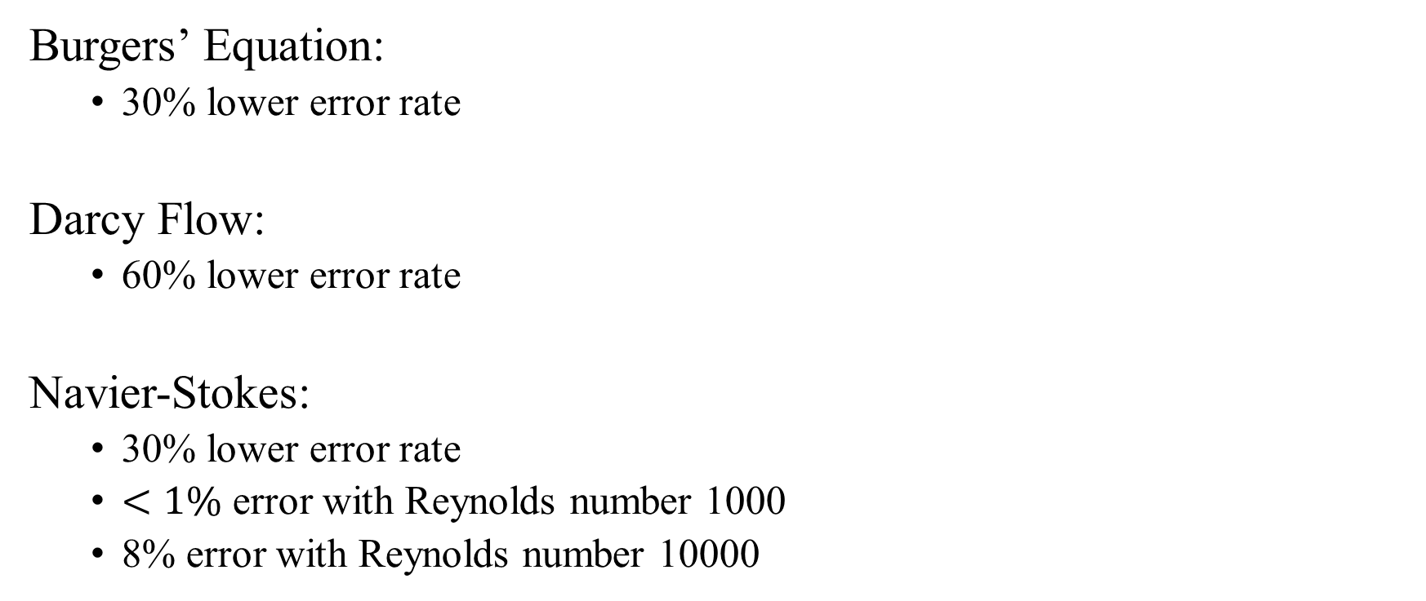
Improvements on PDE solutions
Burgers’ Equation:
30% lower error rate
Darcy Flow:
60% lower error rate
Navier-Stokes:
30% lower error rate
$<1\%$ error with Reynolds number 1000
8% error with Reynolds number 10000

Slide 9
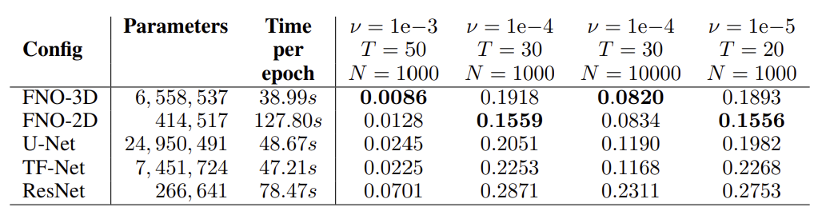

Application to Navier-Stokes
Estimate the solution to Navier-Stokes equation given sparse data in spatial and time domains
Fix $λ_{1}=1$, parameterise $λ_{2}=v$
Spatial resolution $64 ×64$
Time domain $\left[0,10\right]$ in 20 steps

Slide 10
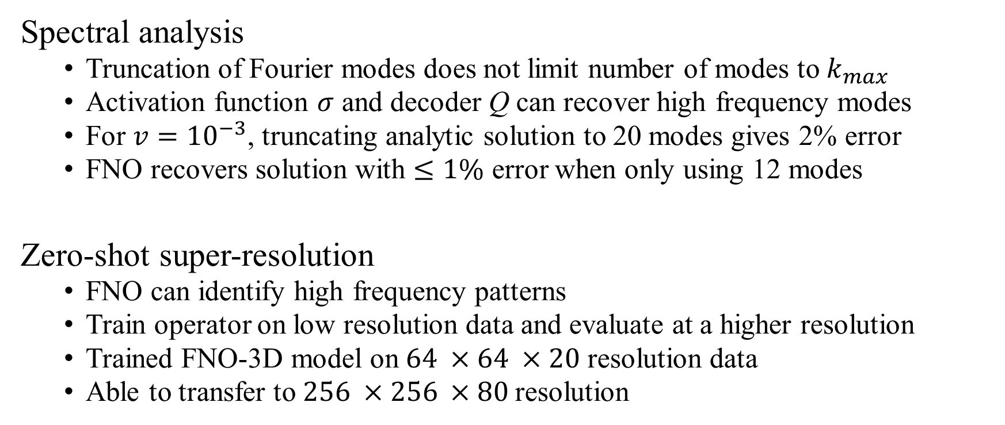
Use cases
Spectral analysis
Truncation of Fourier modes does not limit number of modes to $k_{max}$
Activation function $σ$ and decoder Q can recover high frequency modes
For $v={10}^{−3}$, truncating analytic solution to 20 modes gives 2% error
FNO recovers solution with $≤1\%$ error when only using 12 modes
Zero-shot super-resolution
FNO can identify high frequency patterns
Train operator on low resolution data and evaluate at a higher resolution
Trained FNO-3D model on $64 ×64 ×20$ resolution data
Able to transfer to $256 ×256 ×80$resolution

Slide 11
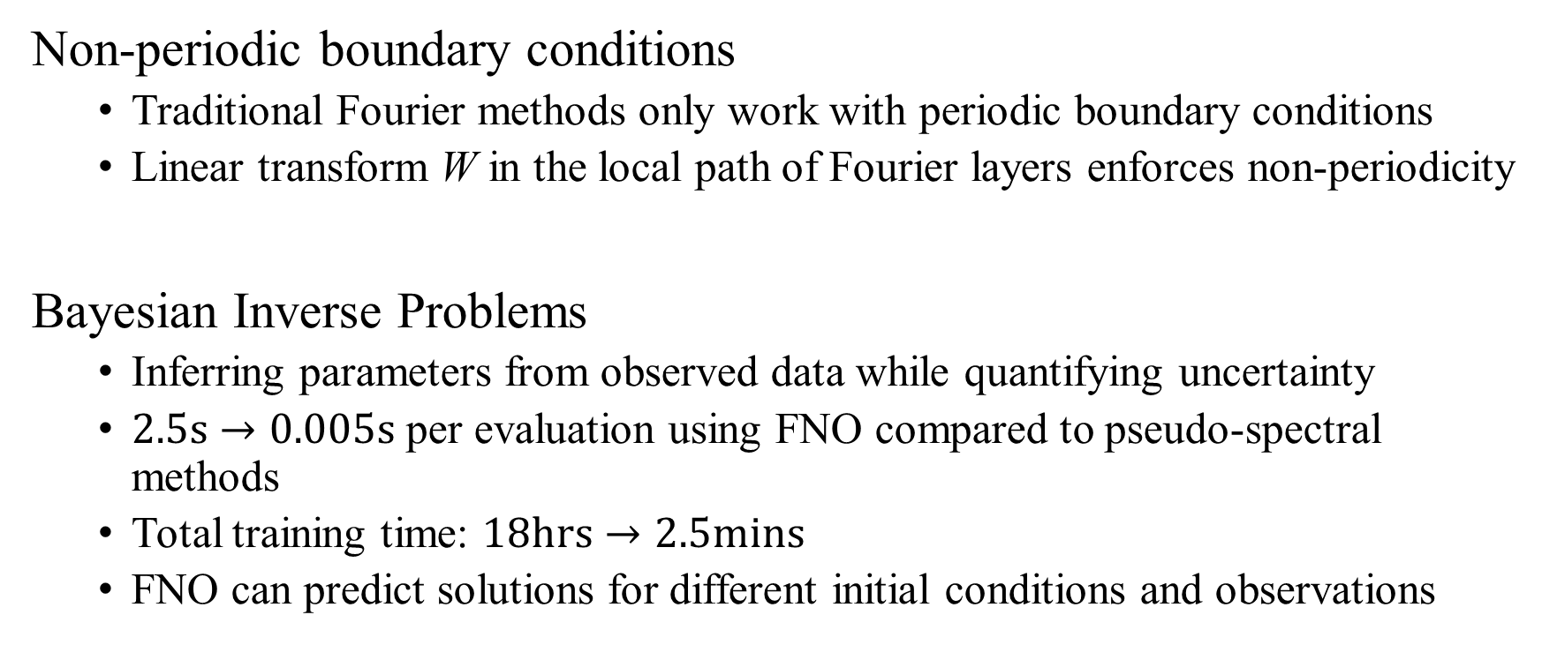
Use cases
Non-periodic boundary conditions
Traditional Fourier methods only work with periodic boundary conditions
Linear transform W in the local path of Fourier layers enforces non-periodicity
Bayesian Inverse Problems
Inferring parameters from observed data while quantifying uncertainty
$2.5\text{s}→0.005\text{s}$ per evaluation using FNO compared to pseudo-spectral methods
Total training time: $18\text{hrs}→2.5\text{mins}$
FNO can predict solutions for different initial conditions and observations

Slide 12
Thank for listening

